Slide 1
Build Automation and SW Servers
Slava Chuhovich

Slide 2
Nightly snapshots of embedded and host software
Automatic documentation generation
Additional SW servers

Slide 3

Automatic nightly builds

Slide 4
Nightly build process
Using Precision Builder tool for automation
Update predefined branches from SVN repo
Build all application executables
Build all tools and utilities
Set EXEs versions based on SVN revision
HASP Envelope executables
Copy the result to network accessible folder
Generate Pass / Fail HTML report
Send report by mail to all team members

Slide 5
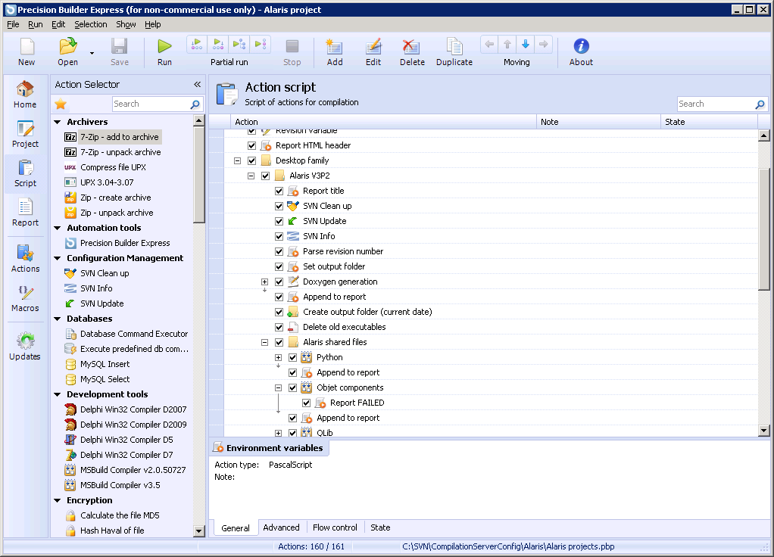
Precision Builder

Slide 6
Nightly build motivation
All release executables are kept and accessible.
Helps tracking exactly when each certain bug had appeared.
Maintaining a sterile build environment ensures repetitive and virus-free installations.
Each auto-build takes about 2.5 Hr, which is actually the time saved daily.
Detailed reporting for each project build.

Slide 7
Branches on auto-build
Following branches and all their subprojects are currently compiled with auto-build server:
Objet1000
Objet500 58.1 Release
Desktop V3P2 (24 and 30)
Objet Studio

Slide 8
Documentation generation

Slide 9
Documentation generation
Update sources from SVN repository (as part of nightly snapshots)
Generate code documentation using Doxygen tool
Update documentation server content
Docs freely accessible from Docs portal
http://dev/docs/

Slide 10
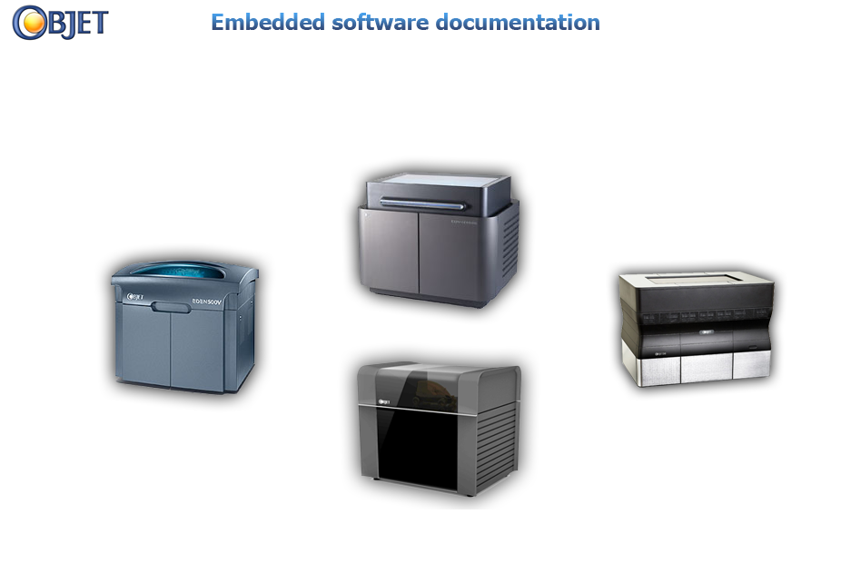
Documentation portal

Slide 11
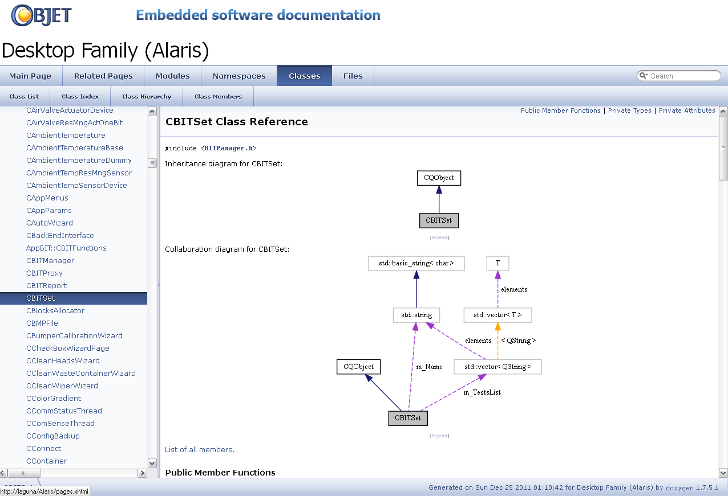
Code documentation

Slide 12
SW Department servers

Slide 13
Servers
Bugzilla
Bug tracking system
Above 100 company-wide users (SW, QA, PMs, Tech writers, Alpha …)
SVN Server
Configuration management (source control)
Above 30 company-wide users (SW, QA, Tech writers, Printing Quality)
Build and Documentation
Software nightly build and documentation portal server
Wiki
A wiki-style knowledge base for the software and projects related issues.

Slide 14
Thanks

